Slide 1
Data Coordinators Meeting
December 4, 2023

Slide 2
Agenda
State Reporting
23-24 BEDS Day Reporting
23-24 Student Digital Resources Survey
23-24 CIA/SCEE
NYSESLAT Pre-ID
Level 0 Updates
PD Reporting
Jan Reporting
Special Ed. Events Reporting Update
SED Testing Updates
3-8 Testing
January Regents
Student Digital Resource Survey
Level 1 Updates
Notes:
Bridget

Slide 3
State Reporting

Slide 4
2023-2024 Student BEDS Day
Applies to Districts and Charter Schools
BEDS Day Enrollment Extract (SIRS 312, 313, 314, 316, 319, 350)
Enrollment by grade, district of residence, and supplemental enrollment counts are collected for calculating preliminary State Aid allocations
BEDS Day Free and Reduced Priced Lunch Extract (SIRS-323 and SIRS-327)
Eligible students must be reported with
5817 – Free Lunch Program or
5806 – Reduced-Price Lunch Program
All must have 0198 – Poverty-from low-income family
Data due: Thursday, January 4
Notes:
Laurie

Slide 5
2023-2024 Student Digital Resources Survey
Student Digital Resources Survey must be completed each school year
Applies to Districts, BOCES, and Charter Schools
All students should be surveyed as well as any new students who enroll during the school year
Data will be used to identify specific needs and target resources and funding opportunities when they become available
L2RPT Verification: SIRS-336 Annual Digital Resources Survey Report
Data due: Thursday, January 25
Notes:
Laurie

Slide 6
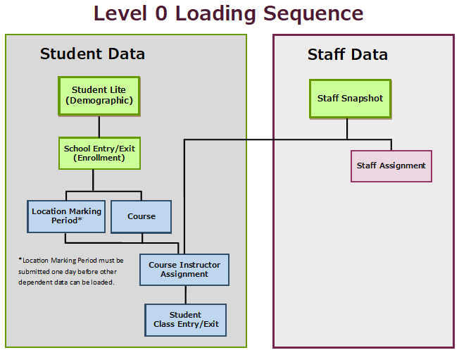
2023-2024 CIA/SCEE
Staff Snapshot, Course Instructor Assignment and Student Class Entry/Exit data
Applies to Districts, BOCES, and Charter Schools
Data will be used by Office of State Assessment for determining counts of students enrolled in courses leading to state assessments
L2RPT Verification:
SIRS-330 Student Class/Course Instructor Summary Report
Begin reviewing SIRS-328 Out of Certification and SIRS-329 Certification reports
Data due: Thursday, January 25
Notes:
Laurie

Slide 7
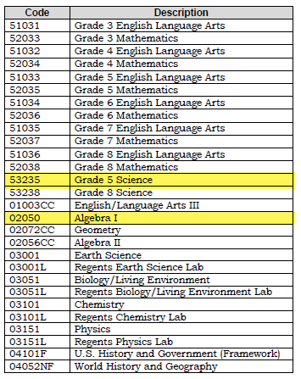
Check State Mapped Course Codes
Grade 5 Science: 53235
New Algebra I Course Code: 02050
Notes:
Laurie

Slide 8
NYSESLAT Pre-ID Data
English Language Learner data for NYSESLAT exam
Must report all 0231 – ELL Eligible and ELL Programs
Data used for pre-printed labels for you NYSESLAT answer sheets
Data due: Thursday, February 1
Notes:
Laurie

Slide 9
DDC Trainings
Fall State Reporting Tasks: We will go over SIRS data that is due in January and discuss best practices for verifying data and meeting SIRS deadlines
Monday, December 11 from 10 am – 11 am
To sign up: https://forms.gle/tXSqmxE2QuuKkwc96
Tools of the Trade: This session provides an overview of the various web applications used by District Data Coordinators. The applications discussed include SEDDAS, SEDREF, Application Business Portal, Monroe SFTP, and more.
Tuesday, December 19 from 10 am –11 am
To sign up: https://forms.gle/sNjYgv86kVoNGuUg9
Notes:
Laurie

Slide 10
Questions?
For the latest State Reporting information, please read the MAARS Weekly Digest sent out each Friday afternoon!
Notes:
Laurie

Slide 11
Level 0

Slide 12
Level 0 Updates: release 19.01
Update window Wednesday December 6th at noon for https://level0.monroe.edu.
Added column to Course report
Added TEACH Name and Status on Informational / Warning report
Data Quality report: Identified students in previous year with Immigrant Program or Crisis code
Expired passwords and users with incomplete answers to security questions.

Slide 13
Level 0 Updates: release 19.01 "Course Level" column in Course Report: Reports > Course
New View

Slide 14
Level 0 Updates: release 19.01 Added TEACH Name and Status for Staff Snapshot report : Reports > Information / Warning > Staff Snapshot > Run Report
Old View
New View

Slide 15
Level 0 Updates: release 19.01 Added Data Quality report for students who maybe impacted by a crisis in the current school year if they have an Immigrant Program (8282) and /or Crisis code in the previous school year : Reports > Data Quality Reports > Select Data Type: Demographics > Select Report: Crisis Impact Summary

Slide 16
Level 0 Updates: release 19.01 Reminders: Notifications on expired credentials and incomplete security questions
EXPIRED
Hello,
This is a friendly reminder that the password for the Level 0 user account, with the following information, has expired:
User Name: Mary Christmas
Password Expired On: 2023-08-30
You may reset your password at any time by going to your Level 0 website.
Thank You
ABOUT TO EXPIRE
Hello,
This is a friendly reminder that the password for the Level 0 user account, with the following information, is about to expire:
User Name: John Doe
Password Will Expire On: 2023-12-10
You may reset your password at any time by going to your Level 0 website.
Thank You

Slide 17
Questions?
Notes:
Laurie

Slide 18
Pupils with Disabilities Reporting

Slide 19
PD BEDS Reporting
October Snapshot Reporting:
Requires Certification of VR’s 1-6, and VR 8
Certification in the PD Data System is DUE January 15th, 2024
LAST upload to Level 0 to make PD System in time: Thursday, January 11th
Required Data:
Demographics/Enrollment
Type of Disability
October Snapshot
Included: Students with an IEP in effect on BEDS day, and with programs or related services that span BEDS day 10/4/23
See VR1-9 PD Verifications Table handout for inclusion criteria and entities that need to certify

Slide 20
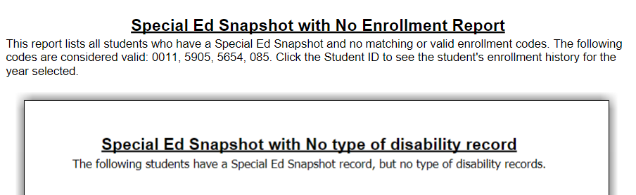
PD Reporting: Verification Reports - L1
Verification Reports > 9) NYSAA and Special Education > Special Ed Snapshot Student List
Verification Reports > 9) NYSAA and Special Education > Special Ed Snapshot Verification Report

Slide 21
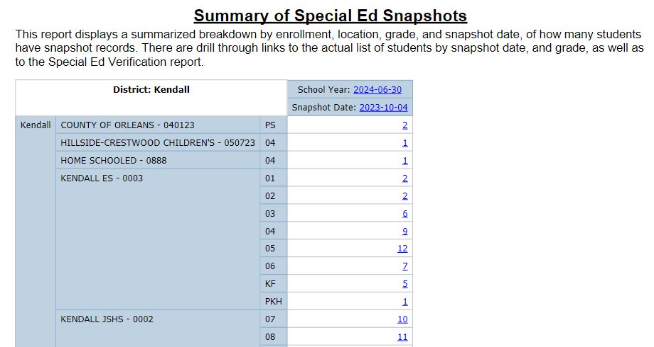
PD Reporting: Verification Reports - L1
Verification Reports > 9) NYSAA and Special Education > Special Ed Snapshot Summary Report

Slide 22
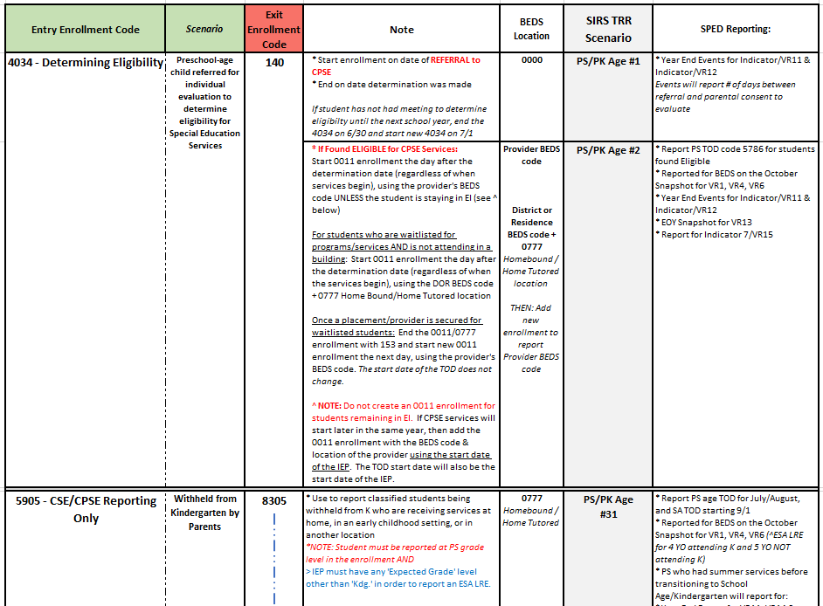
4034 & 5905 Enrollment Quick Glance Table
UPDATED VERSION!!
4034 enrollments, exit codes, subsequent enrollment guidance, and how the data is used for SPED reporting
5905 enrollment scenarios and how data is used for SPED reporting
See handout: 4034 5905 SPED Enrollment and Exit Codes Quick Look Table
Notes:
Handout to help with the 4034 scenario, and have also included 5905 enrollment scenarios because although unrelated to this change, folks tend to have confusion regarding these enrollments.

Slide 23
4034 Enrollments for determining Preschool Special Education Eligibility
COMMUNICATE:
Be sure your SPED department knows to inform the Registrar the status of services for a student who was being determined for preschool SPED services
End the 4034 on date eligibility was determined
Immediately start 0011 the next day at PS grade level - UNLESS the student is staying in EI OR the student was found Ineligible
If provider is known, use provider BEDS code
If student is on waitlist for a provider, use district BEDS code with 0777 location
Report BEDS snapshot record for students who are Classified Preschool and have an IEP in effect on BEDS day, with programs or services that span BEDS day
Notes:
TOD start date does not affect data reported in the October Snapshot:
Inclusion Criteria: Students with an IEP in effect on BEDS day, with Programs/Services that span BEDS day
Not just about communicating or documenting the end of the 4034 enrollment, but also the status of services so that the correct location can be entered for the 0011 enrollment, and subsequent follow-up enrollment can be entered for students:
Waitlisted
Who remain EI but will be starting CPSE services later in the same school year

Slide 24
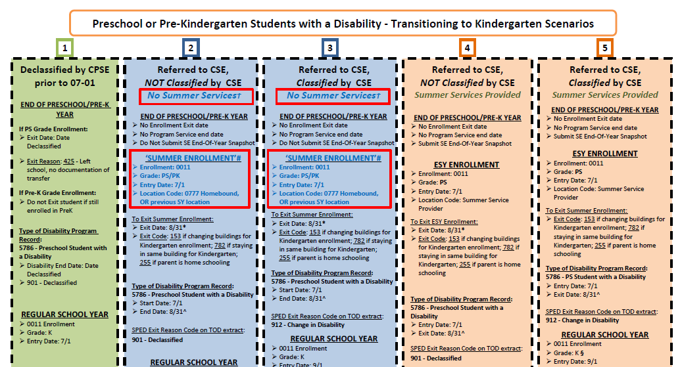
CPSE Transition to Kindergarten Age Table
UPDATED VERSION!!
Notes:
Updated CPSE Transition to K table – important for correctly reporting Events for EOY reporting

Slide 25
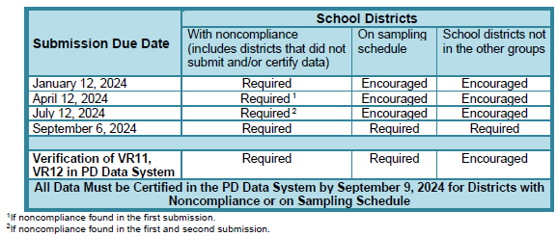
PD SE Events Reporting
All districts are required to submit Special Education Events data for preschool and school-age students referred between July 1 and June 30 for evaluation for Sp. Ed. Services
Different Data Submission Requirement Scenarios
Districts identified noncompliance from 22-23 or 21-22 school years are required to submit Events data in January and September.
Districts on 23-24 Sampling Schedule are required to submit Events data in September
Districts on 22-23 Sampling Schedule that certified inaccurate or submitted that no students met criteria for Indicator 11 are required to submit Events data in September
All other districts are encouraged to submit Events data in September

Slide 26
PD Reporting: MAARS Contacts for Data Reporting
PD Reporting and Frontline IEP:
Kerri Baxendell 349-9077 kbaxende@bocesmaars.org
Level 0:
Matt Fredericks 249-9064 mfrederi@bocesmaars.org
SIRS Data:
Laurie Hazard 349-9051 lhazard@bocesmaars.org
SMS Specifics: Contact your SMS Liaison
Notes:
Call or email if you need help!

Slide 27
SED Testing Updates

Slide 28
3-8 Testing – Keep your ELL department folks up to date
Friendly reminder… any information you may receive concerning NYSESLAT, NYSITEL, English Language Learners data… etc., please make sure your ELL department folks are receiving this information. For example, how to return materials, packing of materials, deadlines … etc.

Slide 29
Paper Based Tests (PBT)

Slide 30
3-8 Testing – Answer Sheets, Rosters & Labels MAARS shipping schedule (tentative)
MAARS Shipping Schedule:
To be determined. As soon as we know when we will have the needed TFT images to create the answer sheets.
CBT Grade Level Answer Sheets:
As in the past, we will be sending out our usual order form/template soon.
These are completed by your district/school, listing the student’s information on the students that will need paper answer sheets.
Keep in mind, for your CBT grade level students, these students must have an IEP or 504 to take the paper version of the test.
As in the past, no rosters or labels will be printed with CBT printed answer sheets.
PBT Grade Level Answer Sheets:
These will be printed along with a set of rosters and labels.

Slide 31
3-8 Testing – Important Dates and Deadlines
More dates will be added to this chart and will be in our Weekly Digest as they are made available.
Important Dates and Deadlines for 3-8 Tests
CBT Tech-Readiness Closes | December 29th
Simulation CBT: Date To Have All Student Data Up-To-Date in Level 1 | December 7th
Simulation CBT: Date Nextera Opens For Student Setup & Test Prep | December 20th
Simulation CBT: Schedule dates for Participation (Reminder: All CBT Schools Are Required to Participate) | Month of December
Simulation CBT: Testing Window | January 16th - January 26
CBT Proctor & Best Practices Training & ScorePoint Training | February - March (actual date TBD)
Operational CBT: Date to Have all Student Data Up-To-Date in Level 1 | February - March (actual date TBD)
Operational CBT: Date Nextera Opens for Student Setup & Test Prep | February - March (actual date TBD)

Slide 32
Assessment Student Answer Sheets Due to MAARS for Processing
Waiting to hear from NYSED on these deadlines for ELA, Math, Science and NYSESLAT
We will keep you all posted as soon as we receive these dates.

Slide 33
3-8 Testing - General information to keep in mind for Premier Scoring
Premier offers 2 types of Scoring services…
Computer based (offered to CBT schools ONLY) – where Premier coordinates/manages the scoring using ScorePoint (Questar/NWEA Scoring system). CR scores go directly to Questar/NWEA to merge with the students remaining part of the test, final scores eventually created and reported by NWEA/NYSED.
Paper (student paper tests only) – where both the test booklet and answer sheets go to Premier, and the CR scores are recorded on the answer sheets, processed by MAARS, sent to the data warehouse (NYSED) for final scores.
It is VERY important to follow Premier's packing instructions when preparing your answer sheets and test booklets for scoring.
Side Note: If using any other scoring vender, your school should carefully follow that vendor’s instructions/directions, NOT Premier’s directions.
It is the responsibility of each school/district to make sure answer sheets are returned to MAARS by deadline for processing.
***CR = Constructed Responses

Slide 34
Computer Based Tests (CBT)​

Slide 35
Computer Based Testing *** CBT Simulation ***
All districts and schools participating in 3-8 computer-based testing are required to also participate in CBT Simulation.
Please make sure all your Level 0 student data is accurate, up-to-date and pushed-up for DW load, by end of day Thursday, December 7th.
NYSED will pull student data on December 8th in preparing for loading to Nextera Admin.
Nextera will open for CBT Simulation setup on Wednesday, December 20th.
CBT Simulation testing window: January 16th – January 26th

Slide 36
Computer Based Testing *** CBT Simulation ***
Nextera is a platform where the students are setup for their testing
Steps that need to be done in Nextera before the testing window opens.
Reviewing students and putting them into "classes" (a class is the same idea as Rostering) This also includes adding any students that were not pulled at the time NYSED had done their CBT student data pull.
Teachers will need to be connected to the class(s) that you will create for their use.
Student accommodations will also need to be applied/added in Nextera to the students that need them.

Slide 37
Computer Based Testing - Resources
CBT Support webpage - Computer Based Testing (nysed.gov)
Click on [Grades 3-8 ELA and Math Computer-Based Testing]
Do a search on a key word to find very helpful articles.
We have a list of updated articles in our Weekly Digest, this list is updated as articles are updated in CBTsupport.
SAM's manual
There is information though out the manual as well as how-to's for setting up your
Nextera for testing including some step-by-step directions
(in the appendix section of the manual).
MAARS – Mari-Ellen Maloney – 585-349-9025 – mmaloney@bocesmaars.org

Slide 38
Computer Based Testing *** CBT Simulation ***
Resource for setting up students in Nextera
Good Articles in CBTsupport
NEW 2023-24: Computer-Based Testing Simulation Guide - Quick Reference Guide
NEW 2023-24: Changing Session Access Codes - Quick Reference Guide
Other CBTsupport articles of interest...
NEW 2023-24: Nextera Setup & Installation Guide
NEW 2023-24 Video Tutorial: Learn How to Edit and Add Students in Nextera Admin
NEW 2023-24: How to Update Teacher Accounts in Nextera Admin - Quick Reference Guide
NEW 2023-24 Video Tutorial: Learn How to Edit and Add Classes in Nextera Admin
Documentation: How to set student testing accommodations for CBT
Test Read Accommodations in Nextera Are Only Provided in English
NEW 2023-24: Text-to-Speech (TTS) - Quick Reference Guide

Slide 39
3-8 Testing – Simulation & Operational CBT – Student Moves within Nextera Admin
District level coordinators (DTC) can move students from one building to another building within Nextera Admin. However, they cannot move a student from another district or school outside their district. However, the RIC's can make these student moves for you.
You will need to complete a student move request via a Google form. A link to this form will be sent to all Operational CBT schools only, both for their CBT Simulation and CBT Operational once the student data has been loaded into Nextera.
Before you request a student move:
You MUST, do a "search" for that student in Nextera Admin using the student's name and/or NYSSIS ID under the student's school name and under just your district name in Nextera (remove the building information under your district name. That seems to work best ).
Try and add the student to your Nextera. If the student is loaded in another location within Nextera, you will get a message stating that.
If you cannot find that student in your Nextera Admin, work with your registrar's office to get the previous district/school information this student attended.
If the student cannot be added to your Nextera, Then complete the "move request" via our Nextera Google Move Request form.
Please make sure you have the student's beds-codes, NYSSIS ID, Local ID ... etc. When entering a move request.
Side Note: Local ID’s are no longer required in Nextera, however we will still collect that information with your request.
If you have any questions, please do contact Mari-Ellen Maloney.

Slide 40
3-8 Testing – Operational CBT - The Importance of Accurate Tested/Not Tested Codes in Nextera Admin
Very Important that schools do this BEFORE Nextera Admin closes
Folks new to CBT and a reminder to CBT veterans, we(RIC/MAARS) have no way to create or run "error checks" on your CBT assessment data like we do for your PBT (paper tests)! The information below is the only way to make sure your student's assessment information is complete, accurate and ready for Questar/NWEA and NYSED.
PLEASE make sure to …
Export the Test Status Details file from Nextera, before/on the last day of testing for review.
Resolve all student exams that still show as "In Progress", make sure ALL reason-not-tested for sessions and over all test are accurate, before Nextera closes.
Review all tested/not tested codes entered in Nextera Admin for accuracy.
Remove session absent on student's the completed that session during make-ups.
Students that have an RNT or absent and have answers on their tests may not get a final score.
Make sure your Administrative Errors are entered and accurate.
Export the Test Status Details file again after your review and updates, before Nextera closes for all exams. This is the only reference you will have on your student's tests once Nextera closes, until NYSED releases the assessment information.
CBTsupport Good Article and PPT: Documentation: How to Set Not Tested Codes
There is a Power Point “Setting Not Tested Codes QRG 2022-23.pdf” listed at the bottom of the above CBTsupport article that will help you run and export the Test Status Detail report

Slide 42
JANUARY 2024 REGENTS
January 2024 Regents:
Pertinent information (including the highlights below) have been updated in the MAARS website at January 2024 (monroe2boces.org).
M.A.A.R.S. Pre-printed answer sheets:
MAARS order form for preprinted answer sheets due 12/8: MAARS January 2024 Regents Preprinted Answer Sheet Order Form
Files of student demographic information is due 12/15 to MAARS through the secure Monroe FTP site. Please do not email files of student information!
Any needed additional walk-in files are due 1/19 and will continue to be accepted by MAARS up to exam time. Last minute answer sheets will be printed to a PDF file and sent to the school for printing.
Do not make copies of pre-printed or blank answer sheets for students to use.
MAARS will start preprinting answer sheets in the last week of December. They will be shipped to Districts/BOCES starting the first week of January. We will notify the other schools when their answer sheets are ready to be picked up at MAARS.
Reminder: The Physical Setting/Physics exam, (course code: 03151) offered in January, is a Restricted Test which means each test is numbered and sealed with an answer sheet in its own envelope. You will NOT receive preprinted answer sheets from MAARS for this exam.

Slide 43
STUDENT DIGITAL RESOURCE SURVEY
If using MAARS for Preprinted Survey Sheets please reach to Patty Zeiner at pzeiner@bocesmaars.org or 349-9053
Deadline to have data uploaded to Level 0 and pushed to Level 1 is Thursday, January 25th

Slide 44
Timely Level 1 Updates
Tips and Tricks for the COGNOS Upgrade
Regents Individual Student Report

Slide 45
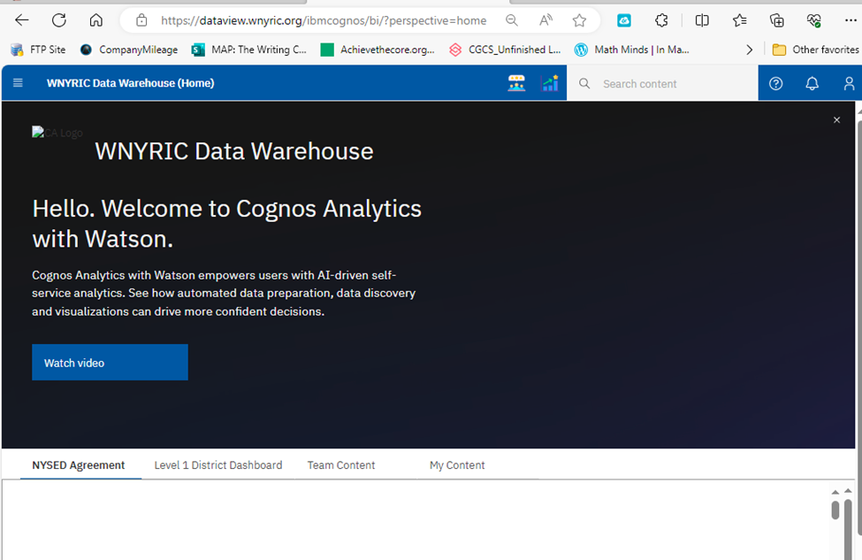
Tips and Tricks for the COGNOS Upgrade
Close this window.
No need to watch the video.

Slide 46
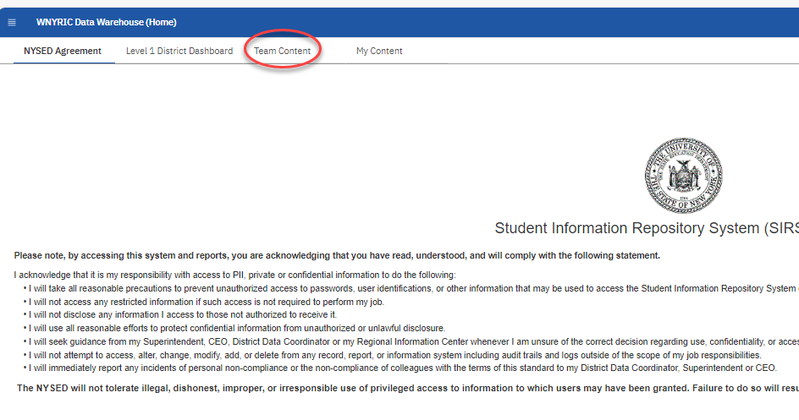
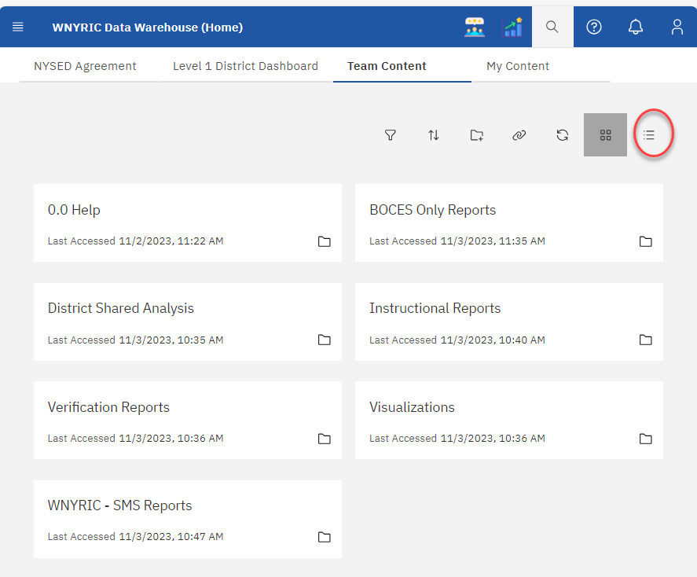
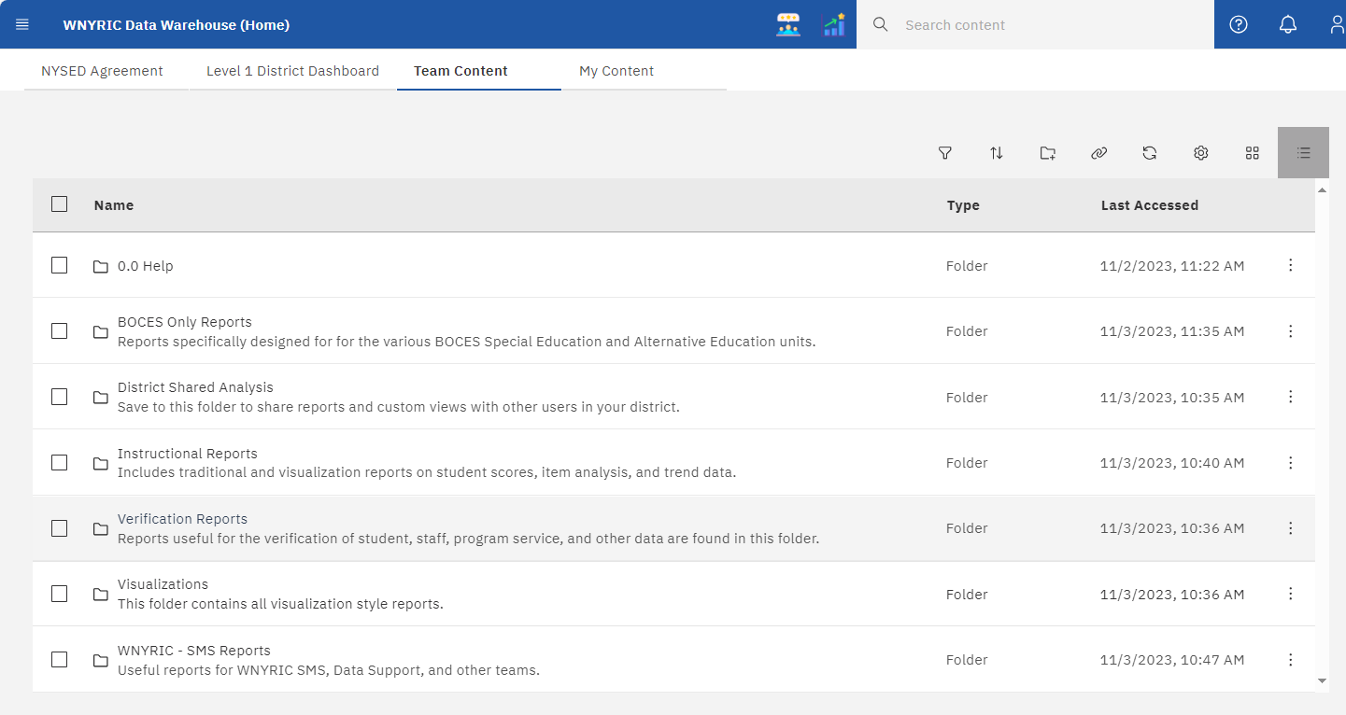
I Want it to Look the Way It Used to Look

Slide 47
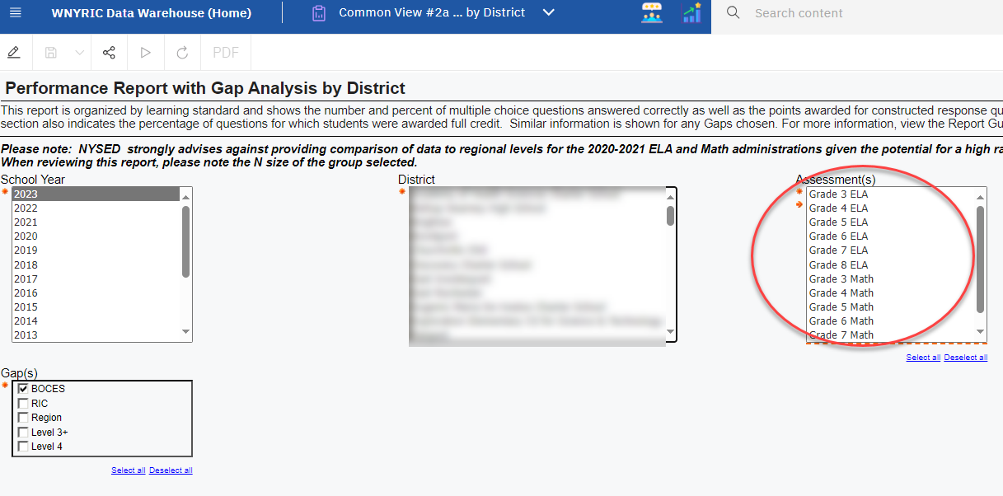
Reset and Run

Slide 48
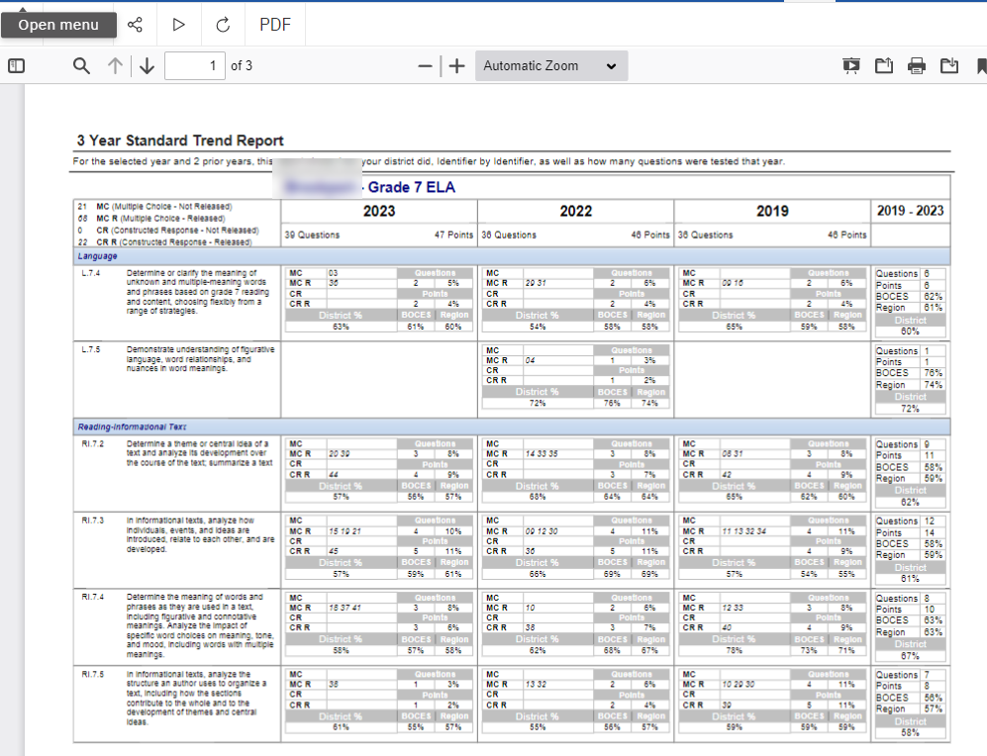
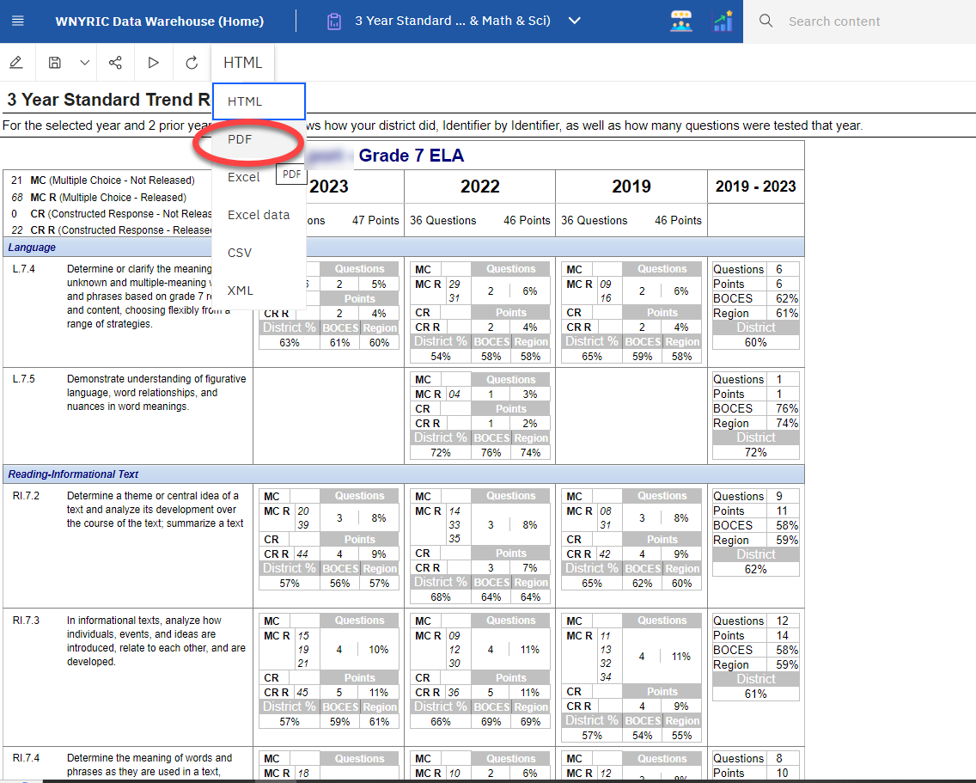
To Run as Something Else: PDF, Excel, etc.

Slide 49
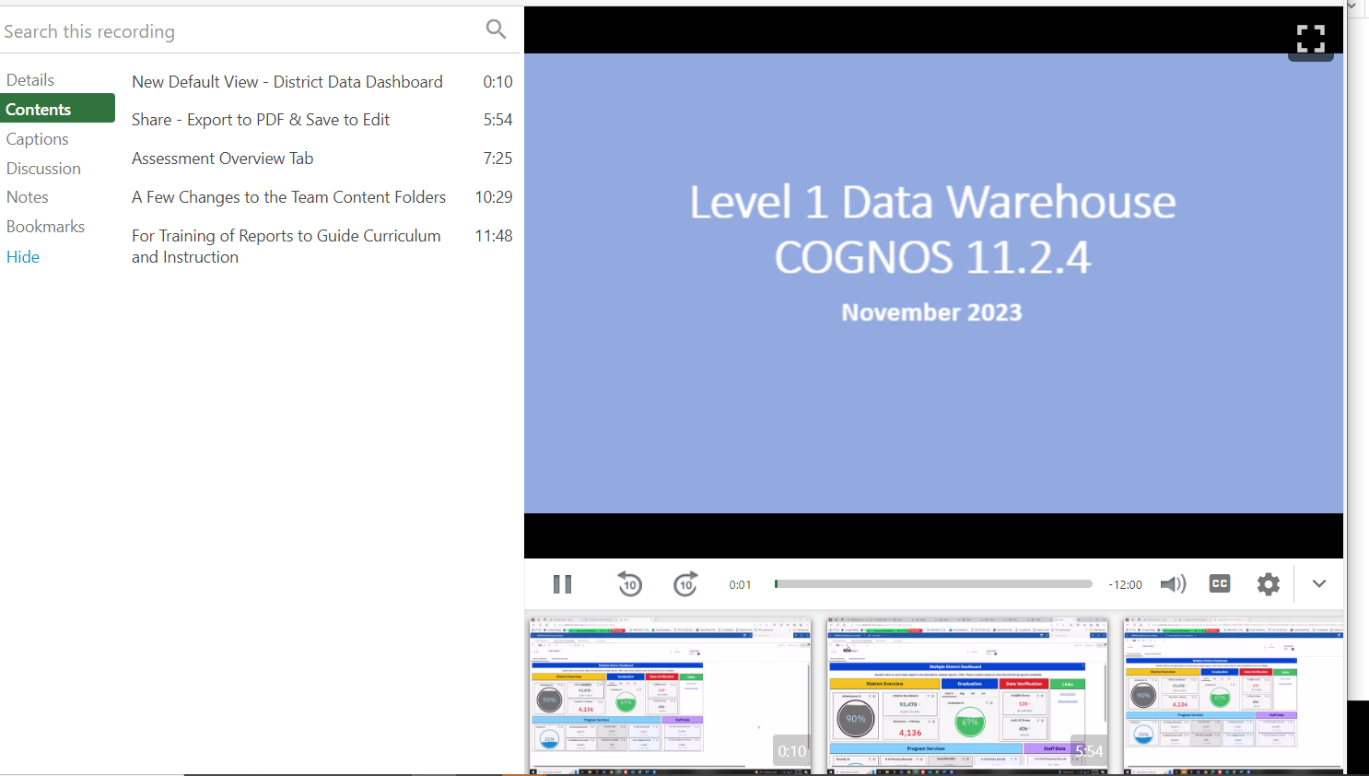
Watch/Share the Video
Link to Video
You can navigate to different sections of the video by selecting certain "chapters."

Slide 50
Who Should Be Trained/Retrained in your district?

Slide 53
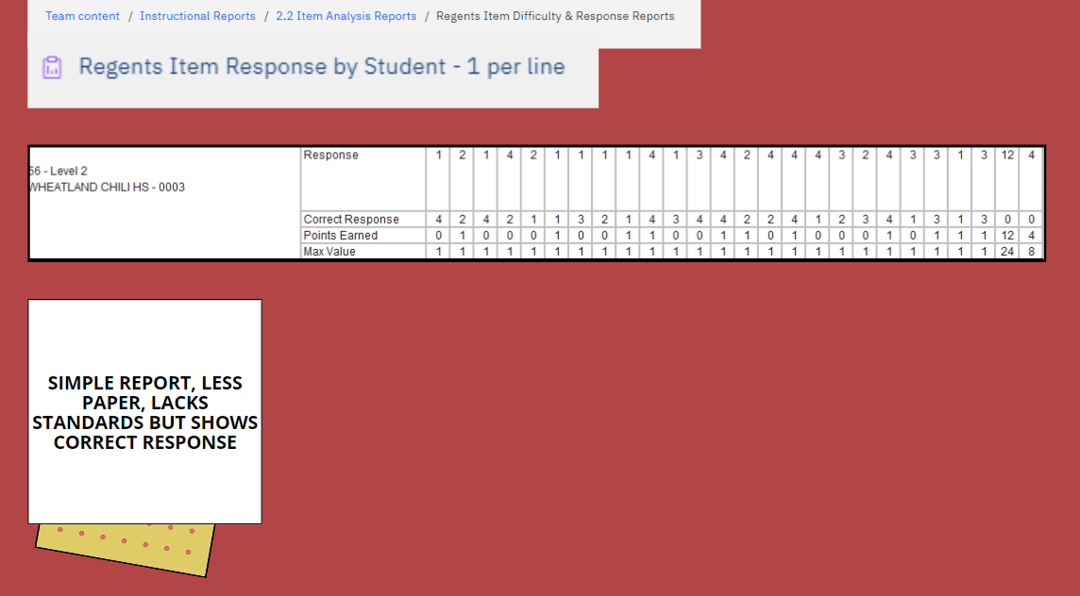

Slide 54
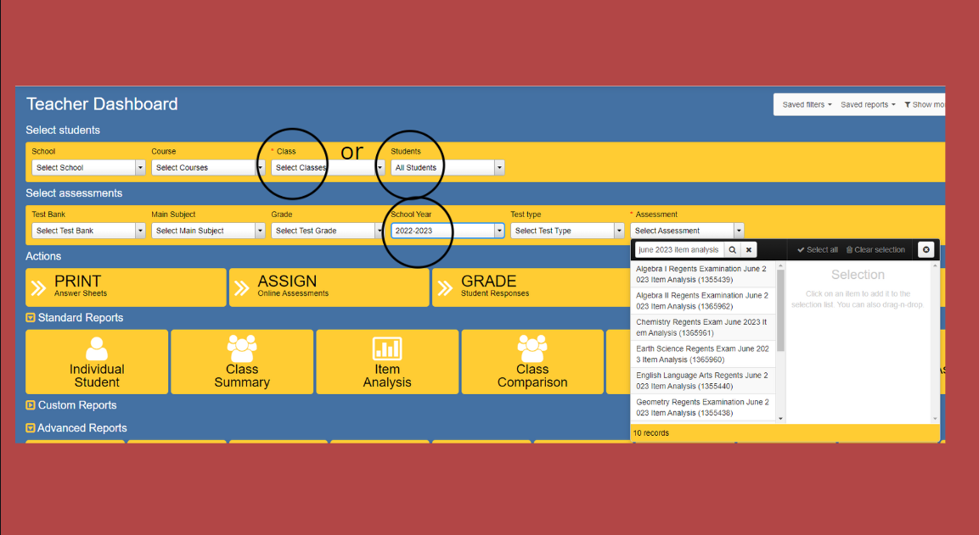
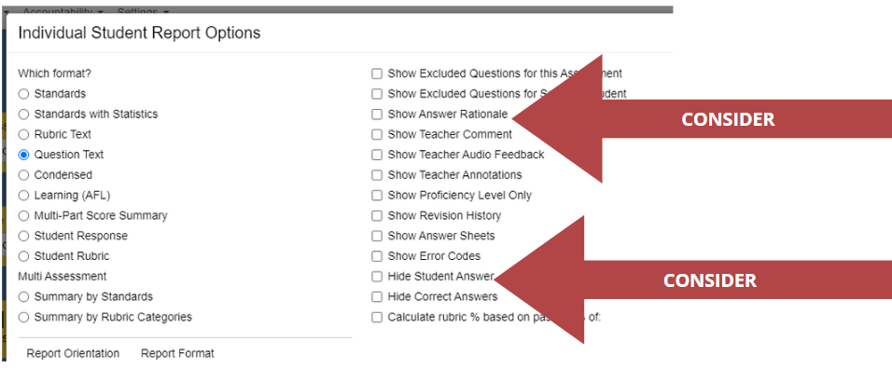

Slide 55
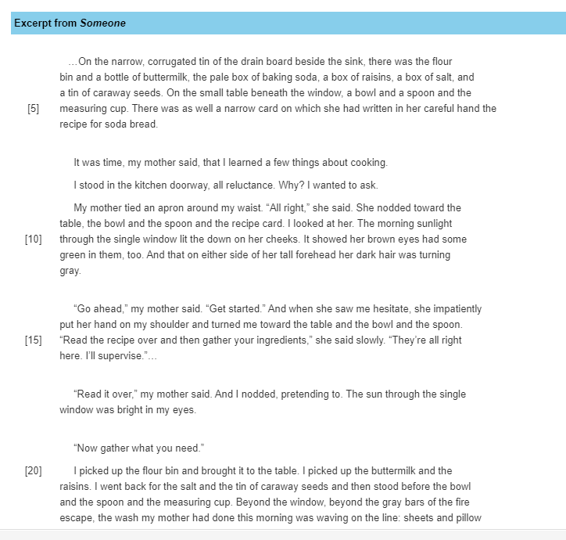

Slide 56
What if you emailed these to your ASI?

Slide 58
Thank you!
Notes:
Bridget

